Slide 1
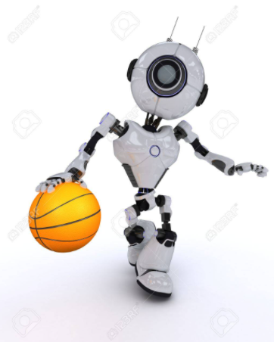
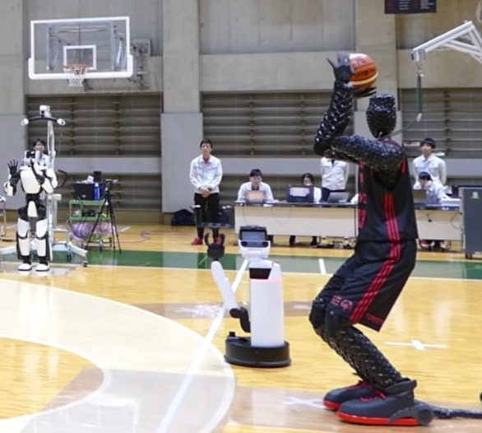
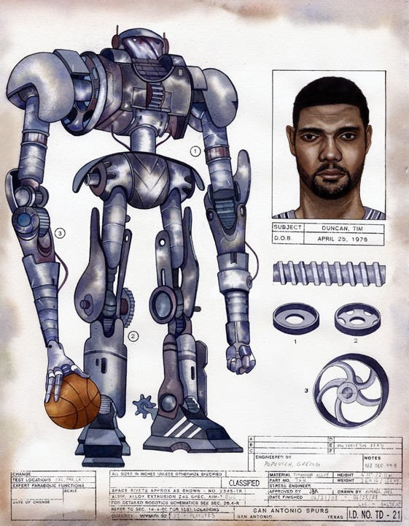

Project title & description
NBA player robot replacer
Using Automated Machine Learning to Predict NBA Player replacement

Slide 2

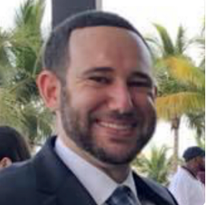

TEAM MEMBERS:
Juan Ulloa | ulloajuan@hotmail.com
Adam Burstyn | adam.burstyn@gmail.com
Ignacio Domaica | idomaica@gmail.com

Slide 3
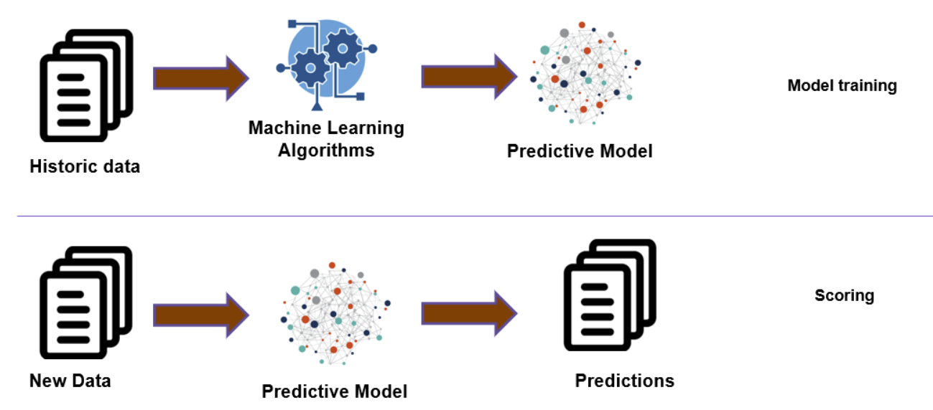
Scope
The idea would be to determine which player is best suited to fill a certain position on any NBA team based on existing players and-or including draftees or not.

Slide 4
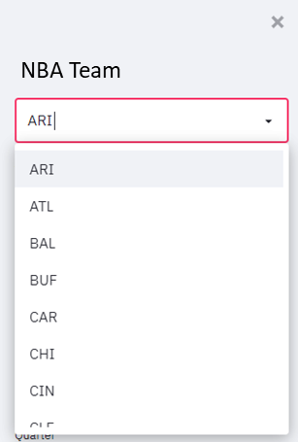
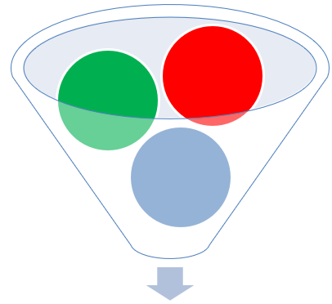
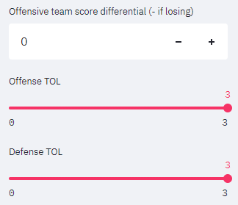
Design / Steps
STEP 1.- Select specific team
Select specific player
STEP 2.- Selected player will have specific performance reflected in stats.
Specific performance data can be loaded as defaults to make corrections using additional tools, like sliders, filters, etc?
DATA.- Will be collected from:
Kaggle
NBA stats
https://www.basketball-reference.com/leagues/NBA_2021.html
https://hoopshype.com/salaries/players/

Slide 5
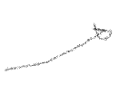
Design / Steps (2)
CLOSEST PLAYER PERFORMANCE COMPARISON
XXXXX
Most similar
Including every stat and similar performance
Explain salary size dots
Color red or team colors
Team colors dictionary if possible
Glossary
SALARY
Specific players have contracts and salaries. Do we want to filter players also with salary data to respect salary caps?

Slide 6
Design / Steps (3)
STEP 3.- Apply models and machine learning to make proper forecasting / predictions
Will make up to 5 recommendations:
Closest player
Closest player including salary

Slide 7
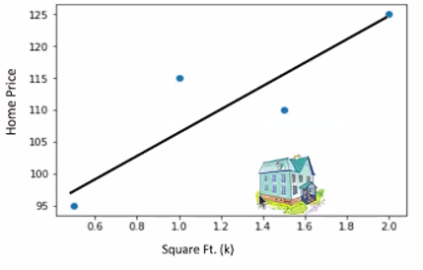
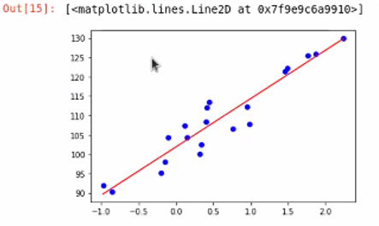
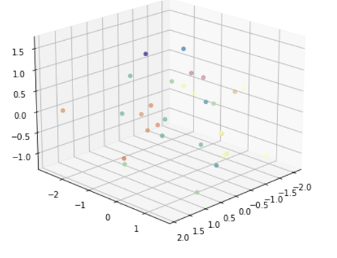
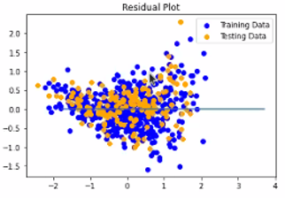

MODELS
Clustering
Euclidean distance

Slide 8
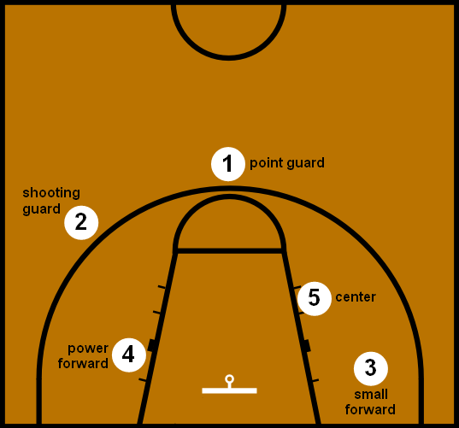
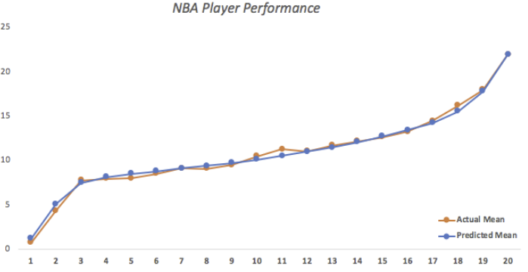
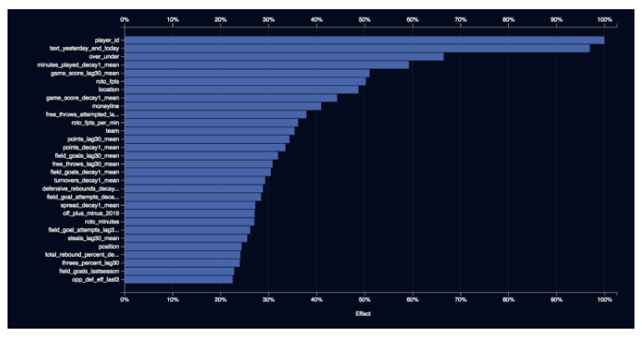
VISUALIZATIONS
To be determined:
Pyvis, network graph
Maxplotlib

Slide 9
BACK UP
9

Slide 10
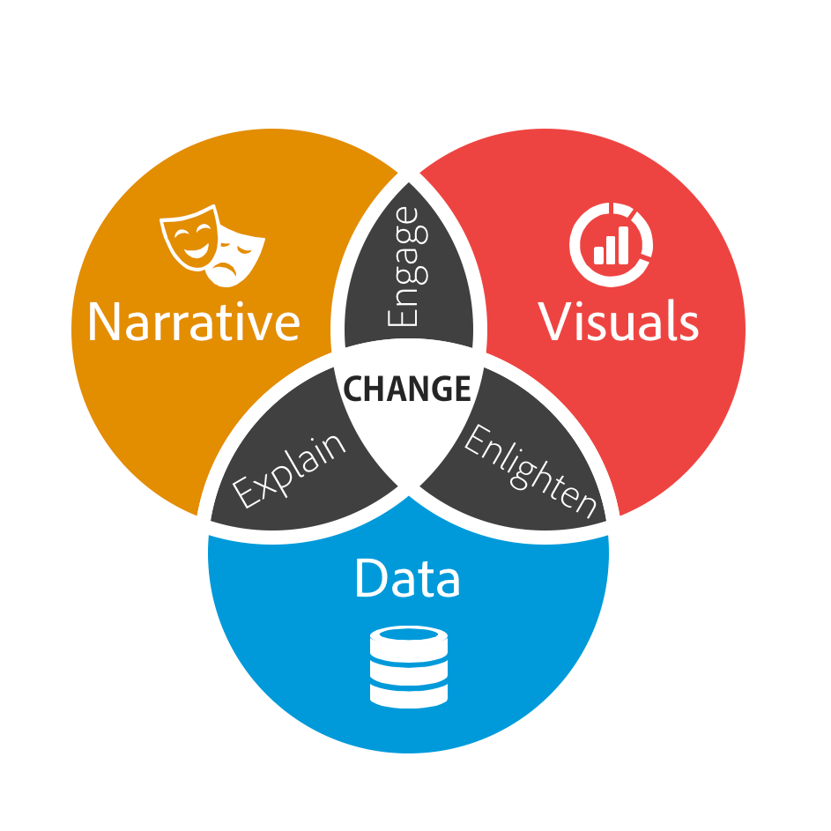

Slide 11
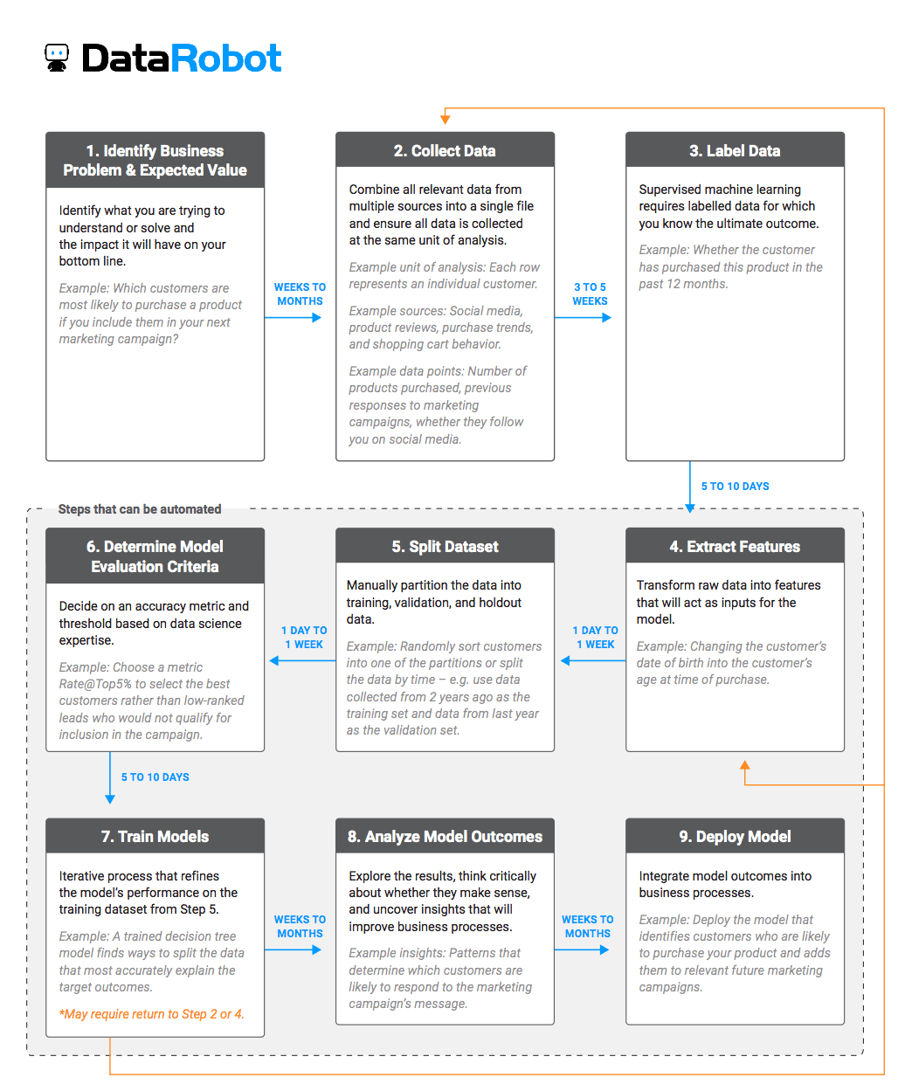

Slide 12
